Slide 1

Exploring Exoplanets Pioneering Interstellar Discoveries
Group Members
Rishav Upadhaya.
Nikhil Kumar.
Soumyajit Biswas.
Under the supervision
Dr. Sourav Saha

Slide 2
Presentation Topics
Introduction
Analytic challenges
Modelling
Challenges & Mitigation
Learnings & next steps
Transit technique
Evaluation

Slide 3
Introduction
Exoplanet is a celestial body(object in space) that is in orbit around a star outside of our solar system.
There are several methods that are used for prediction of exoplanet which are:
Transit method ,Doppler method , Direct Imaging
we have used for exoplanet prediction here is Transit method.
The transit method involves monitoring a star's brightness over time .

Slide 4

Transit technique:

Slide 5
Analytics Challenge
Domain Chosen – Space science.
Importance of this domain - To find out if life exist beyond earth.
Impact this domain -Inspiration for Future Missions, opens new dimension of study in form of astrobiology.
Leaders in this domain - ISRO,NASA, other space agencies.
Maintaining leadership - Investing in future centric technologies by Continuous Research and Innovation.

Slide 6
Data Collection
The Data that relates to the problem(s)
Data Source: https://exoplanetarchive.ipac.caltech.edu/cgi-bin/TblView/nph-tblView?app=ExoTbls&config=PS
Tools used:
1) Microsoft Excel.
2) Python – EDA and Data Visualization.

Slide 7
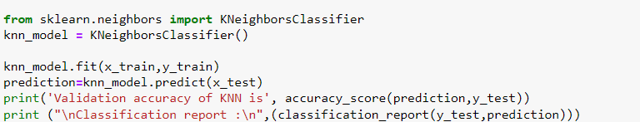
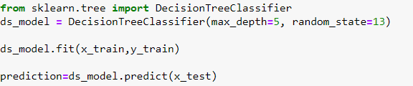
Modelling
Data Splitting: Divide the dataset into training and testing subsets. The
training data was about 85% of the total data set.
Model Selection: using the scikit-learn libraries in Python we have implemented two classification algorithm 1)K-NN. 2) Decision Tree.
Model Training :

Slide 8
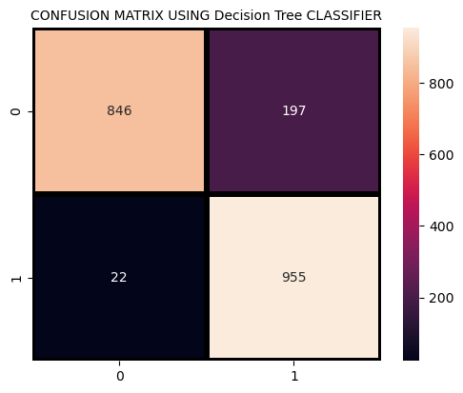
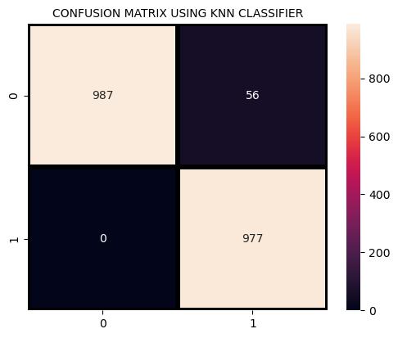
Evaluation
Evaluation the models' performance using appropriate evaluation metrics for classification tasks.
Model Comparison:
Validation accuracy of KNN is 0.9722772277227723.
Validation accuracy of Decision Tree is 0.8915841584158416.

Slide 9
Challenges & Mitigation
Challenges Mitigation
Data Cleaning: presence of outliers and categorical data types.
Data Volume: Analyzing voluminous data can be computationally intensive.
Data Imbalance: Highly imbalanced cause the model to predict the majority class .Hence, the accuracy would be high .
Data Normalization to ensure that all features are on a similar scale.
Removal of outliers and changing data types to numeric
By selecting models that are computationally efficient like decision tree.
By resampling the data ex- increasing instances of minority class
Feature with a larger scale can dominate, leading to biased results

Slide 10
Learnings & future plan
Confirmation of Exoplanet Existence confirmation that exoplanets are common in the universe.
Diversity of Exoplanets based on the flux change we could say that exoplanets come in variety of sizes
Astrobiology expanded the field of astrobiology, exploring the conditions required for life to exist beyond Earth
Astronomical research and exploration because potential habitability of other worlds beyond our own solar system

Slide 11
THANK YOU
Celebrate Your Worth
http://www.praxis.ac.in

